Slide 1
STUDENT NAME: PHANICE MITCHELLE MONG’ARE INSTITUTION NAME: SEVENNET BOOT CAMP CLASS UNIT: MS EXCEL- PIVOT TABLE/ PIVOT CHART INSTRUCTOR NAME: MR.RAGHUVENDRA ANSHU 13/07/2024
FINAL MS EXCEL PROJECT- MOVIE DATA SET

Slide 2
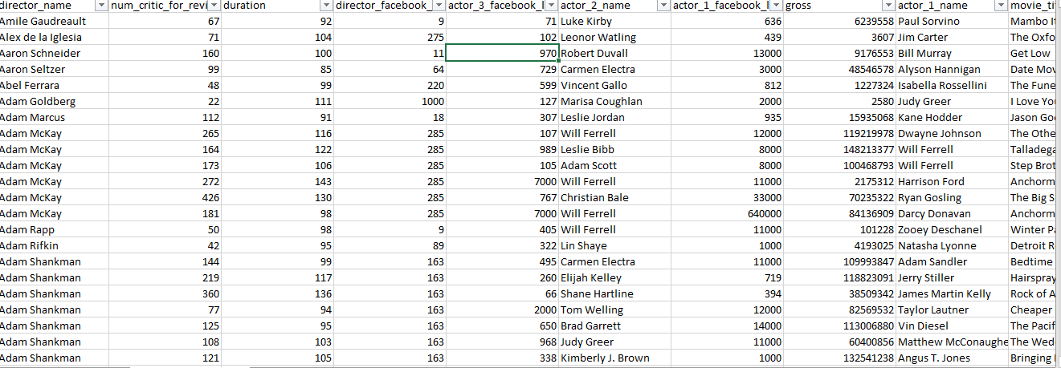
DATA CLEANING- FILTERING BY ADDING FILTERS AT THE ROW HEAD

Slide 3
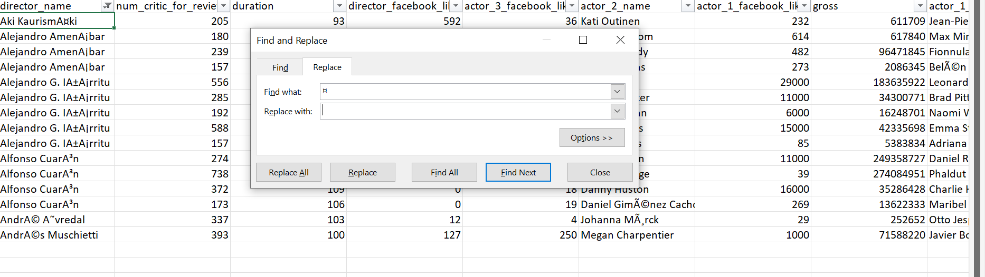
FINDING AND REPLACING OF ERRORS

Slide 4
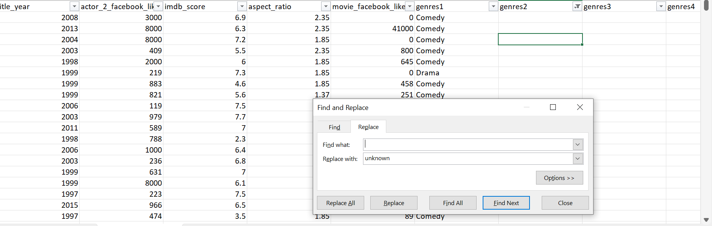
FILLING THE MISSING DATA WITH UNKNOWN NB: For missing numerical data, fill in the gaps with the average of the available data

Slide 5
The popularity of the cast of a movie effect on the gross profit of a movie.
Movie Genre | Sum of Sum of gross | Sum of Sum of actor_1_facebook_likes
Action | 74727850153 | 8523465
Comedy | 38724616521 | 6634838
Adventure | 32960581692 | 3002641
Drama | 21409249780 | 5094966
Crime | 8367257910 | 2289427

Slide 6
The genre of a movie versus profitability. Below are the top 5 highest earning genre. The genre is being brought out to be a key factor when considering the movie to produce.
Genre | Sum of Sum of profit
Adventure | 6473602117
Action | 5877535732
Horror | 3370369843
Comedy | 3212342514
Biography | 2263663972

Slide 7
The total cast Facebook likes does not relate directly to the gross profit of a movie. Below are the top 5 highest earning movie and the total Facebook like of the cast.
Movie title | Sum of Sum of gross | Sum of Sum of cast_total_facebook_likes
The Avengers | 1246559094 | 175394
Alice in Wonderland | 668370412 | 159914
Anchorman: The Legend of Ron Burgundy | 84136909 | 656730
The Final Destination | 66466372 | 303717
Hardflip | 96734 | 263584

Slide 8
The profit of a movie and its relationship to the country,
Country | Sum of Sum of profit
USA | 52792710499
UK | 1574370487
New Zealand | 245159794
Canada | 218593263
Australia | 206668349

Slide 9
The language used in a movie If many people understand then it will earn more profits.
Language | Sum of Sum of profit
English | 53618528879
Maya | 10859889
Persian | 8007674
Indonesian | 2489344
Hebrew | 783276
Romanian | 595783

Slide 10
The movie IMDB score also depends on the genre of a movie
Movie genre | Sum of Sum of imdb_score
Comedy | 6101.6
Action | 6031.9
Drama | 4569.6
Adventure | 2417.1
Crime | 1769.8

Slide 11
The more popular a leading actor is the higher the budget of the movie.
Actor Name | Sum of Sum of actor_1_facebook_likes | Sum of Sum of budget
Johnny Depp | 1560000 | 3136600000
Robin Williams | 1225000 | 1346400000
Robert De Niro | 924000 | 1535500000
J.K. Simmons | 744000 | 1907300000
Jason Statham | 650000 | 1001474000

Slide 12
The profitability of the movies over the years. The below pivot chart and table show there is no actual trend over the year rather it shows that there are other factors that affect the profitability of a movie.
Title year | Sum of Sum of profit
2002 | 2255673159
2007 | 1688356517
2001 | 1456639220
2000 | 1291784849
1999 | -64985886
2004 | -1089833141
2005 | -6048602335
2006 | -11680023386

Slide 13
The directors vs the budget and gross profit. Below data shows that some directors are able to work with a certain budget and maximize on the gross profit earned.
Director | Sum of Sum of gross | Sum of Sum of budget
Steven Spielberg | 4114233101 | 1627900870
Peter Jackson | 2289968050 | 1512000000
Michael Bay | 2231242537 | 1587000000
Tim Burton | 2071275480 | 1247000000
Sam Raimi | 2049549198 | 1430600000

Slide 14
The popularity of the director and the sum profit seems to be dependent on the movie itself because the director an be popular but the profit earned is minimal.
Director Name | Sum of Sum of director_facebook_likes | Sum of Sum of profit
Steven Spielberg | 350000 | 2486332231
Clint Eastwood | 304000 | 610221100
Martin Scorsese | 272000 | 309800
David Fincher | 210000 | 213904524
Woody Allen | 209000 | -154557
Tim Burton | 208000 | 824275480
Christopher Nolan | 176000 | 808227576
Tony Scott | 144000 | 155953673
Quentin Tarantino | 128000 | 323939594
Harold Ramis | 88000 | 133642374

Slide 15
THANK YOU
Your passion for teaching shines through in every lesson. Thank you for inspiring me and thank you for the great skills you shared with me.

